Slide 1
CIS 536 Project presentation: Kansas State Vet Med Library
Yuto Wada

Slide 2
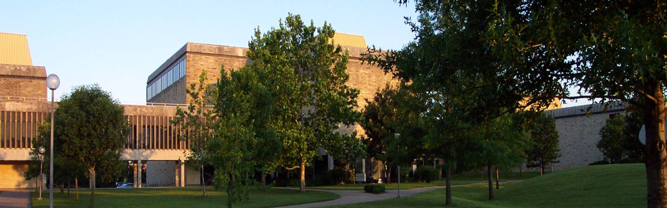
Overview
Virtual tour/ 3D modeling of Kansas State University Vet Med Library

Slide 3
Problems
No existing 3D model for students to see
They have to come in person
Can’t get in without keycards

Slide 4
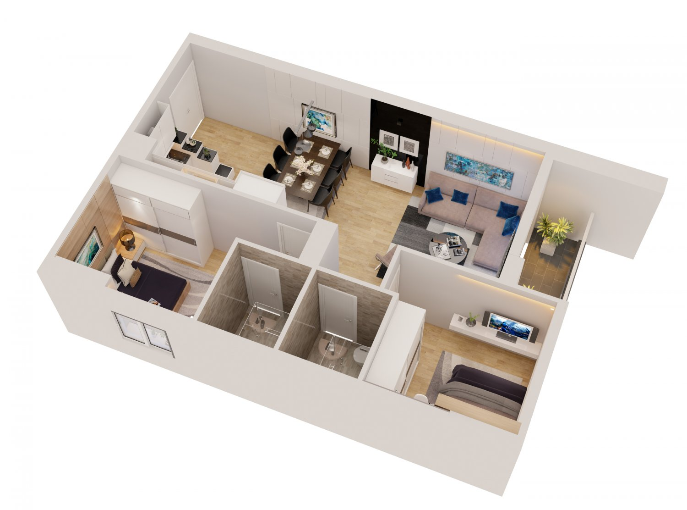
Inspiration
3D modeling from apartments.com
3D modeling that was available for Hale library while it was being rebuilt
Virtual tour of the Athletics building at K-State

Slide 5
Goals
Make a library that look somewhat similar to the actual library
Make the layout as accurate as possible without losing the big picture
Be able to look somewhat realistic with lighting and shadow.

Slide 6
Background
Research into ProBuilder using Tutorials by Hilmi Yafi A
Find the Floor plan of Trotter Hall
Research into making my own texture

Slide 7
Tools
ProBuilder
Used to build wall, glass, and many other things.
Made it easier for me to build shapes and things that I could not find in the unity Assets store
Unity Assets store
Looked up some preexisting prefabs,
Saved me time with materials and prefabs

Slide 8
Steps
Take pictures of the Library
Get the floor plan
Make walls
Add glass walls
Add all the furnitures
Walkthrough

Slide 9
Pictures

Slide 10
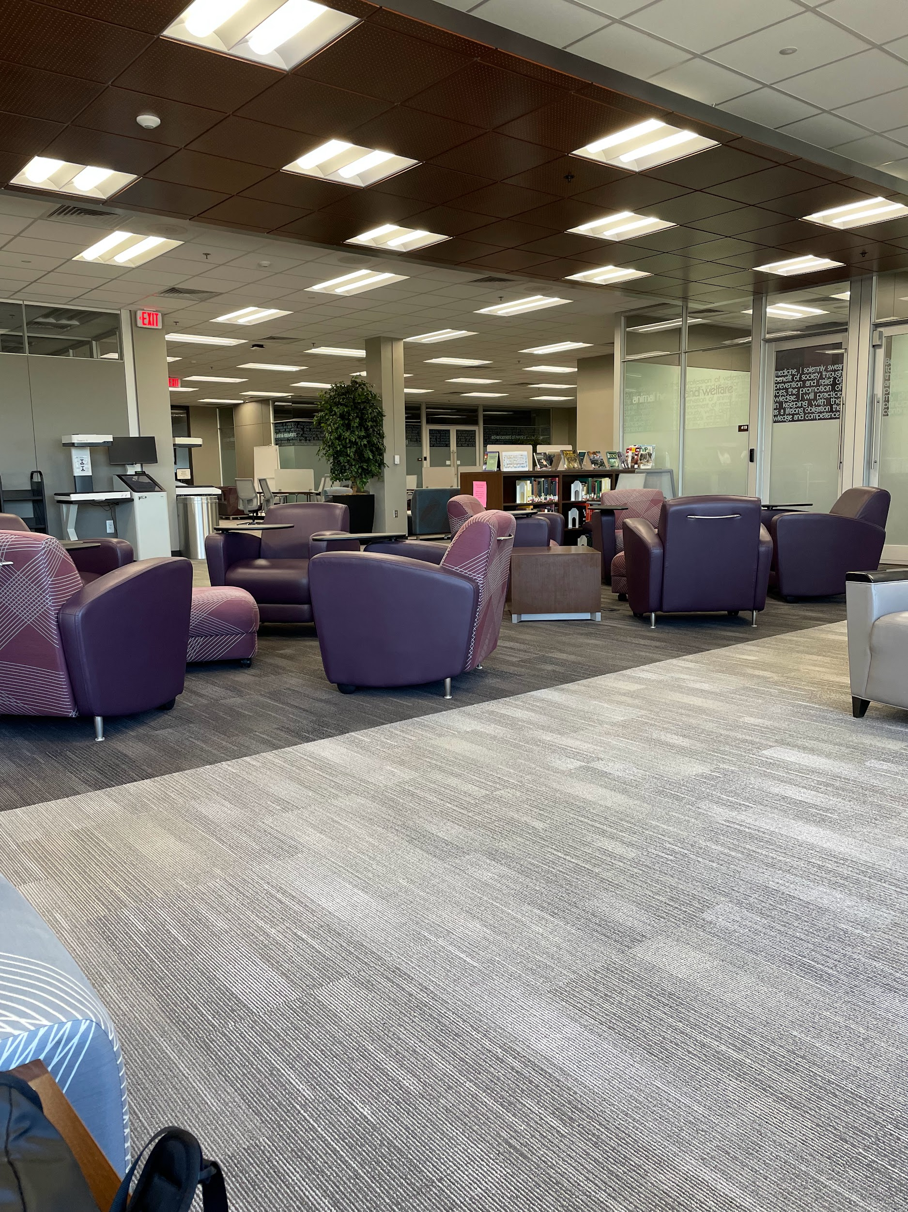
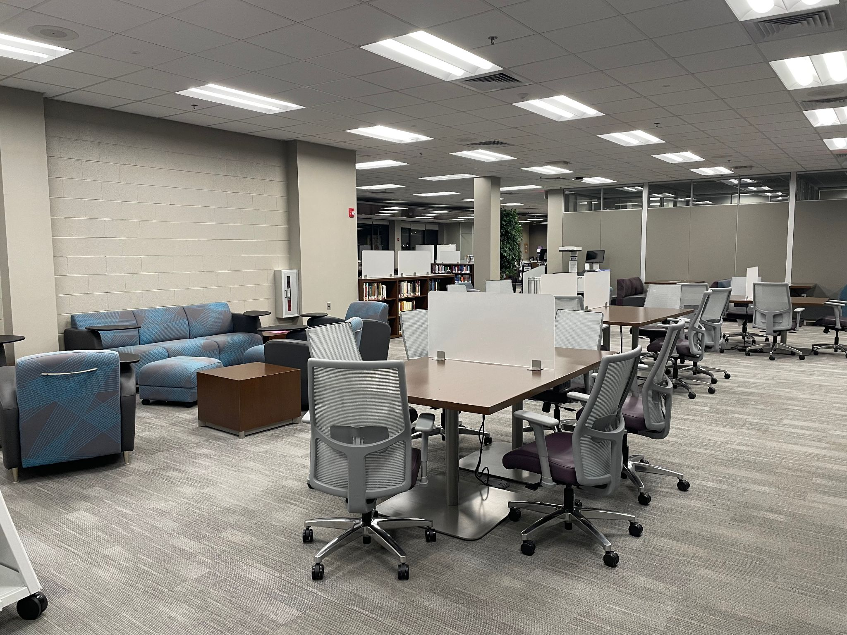
Pictures of library
https://drive.google.com/drive/folders/187WCP8a4ys0_j0JD4_z4Ri9lpFpFAd2P?usp=share_link

Slide 11
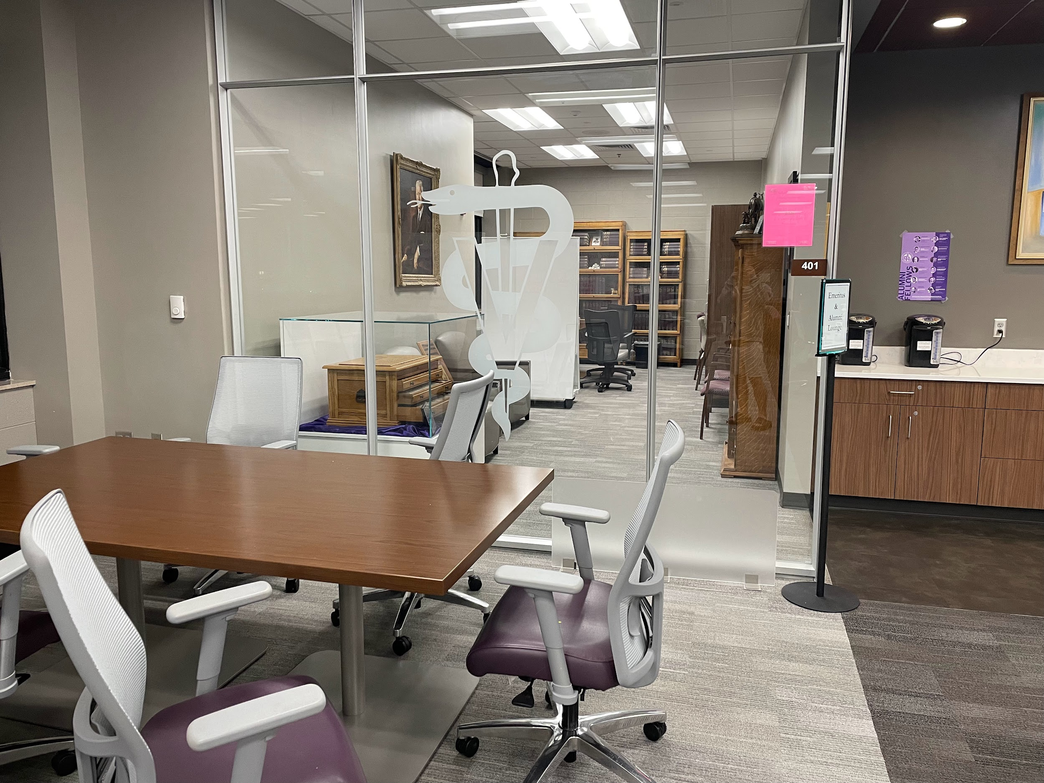
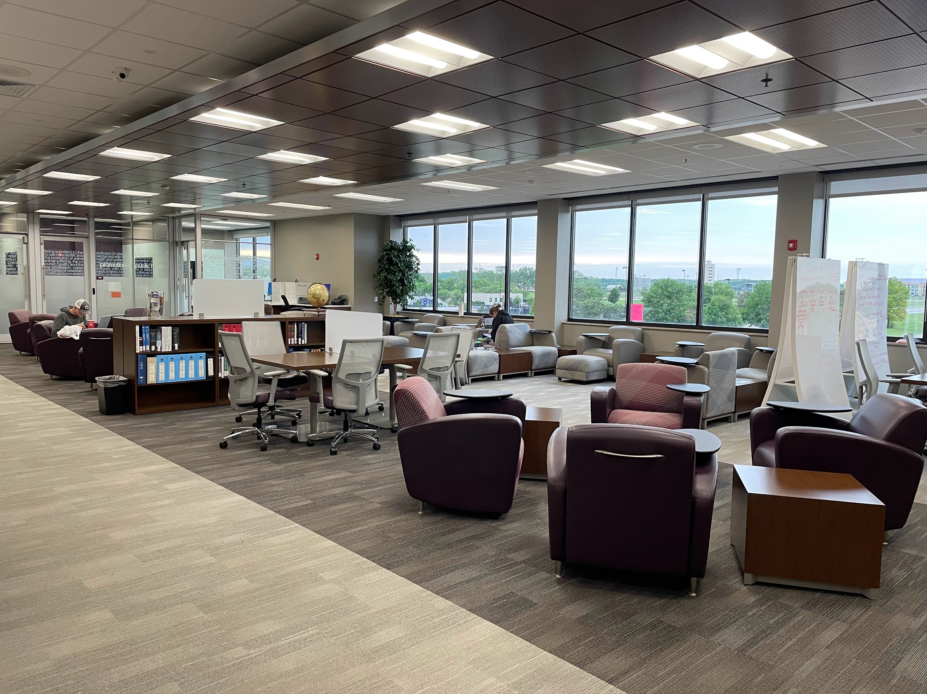
More Pictures

Slide 12
Demo

Slide 13
Next steps
Add more detail
Lakes details in many places
More accurate furniture
Furnitures colors and shapes are well off
Add more rooms
Some rooms had to be left out for time constraint

Slide 14
Citation
Trotter Hall Floor Plan:
University, K. S. (n.d.). Information Technology Services. Login - Sign in | Kansas State University. https://www.k-state.edu/facilities/projects/space/inventory/floor_plans/index.html
ProBuilder Tutorial:
YouTube. (2022, January 11). Unity Probuilder house building #1 in real-time. YouTube. https://www.youtube.com/watch?v=ElNfaUFpqmc&list=PLuVz-FGt23yLxDo1bjaFoslJoS3Ds5Iw_
GIMP Remove Shadow Tutorial:
Remove shadows in source images. Remove Shadows in Source Images - The DarkMod Wiki. (n.d.). https://wiki.thedarkmod.com/index.php?title=Remove_Shadows_in_Source_Images

